Slide 1

Embedded Capture the Flag (eCTF)
The MITRE Corporation and Riverside Research
Fall 2021
© 2021 THE MITRE CORPORATION. ALL RIGHTS RESERVED. Approved for public release. Distribution unlimited 20-03314-12.

Slide 2
What is the eCTF
Design-Build-Attack competition
Run on an embedded platform
Teams must implement a secure design
Functional requirements
Security requirements
College/University (and high school) teams from across the country
© 2021 THE MITRE CORPORATION. ALL RIGHTS RESERVED. Approved for public release. Distribution unlimited 20-03314-12.

Slide 3



Organizers
© 2021 THE MITRE CORPORATION. ALL RIGHTS RESERVED. Approved for public release. Distribution unlimited 20-03314-12.

Slide 4
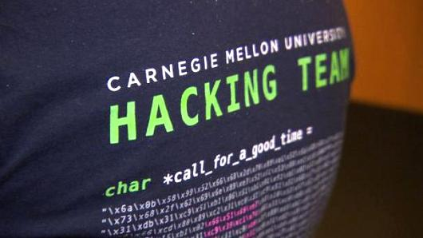
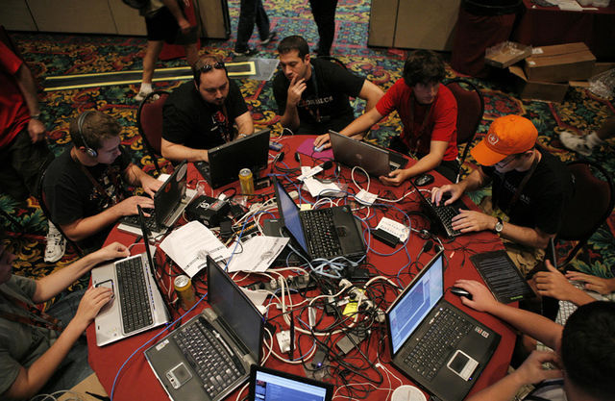
What is a CTF
Capture the flag (CTF)
Cybersecurity competition
Solve challenges to capture “flags”
Capture-the-Flag (CTFs) competitions have proven to be an effective way to grow the cybersecurity workforce and strengthen cyber skills
The Plaid Parliament of Pwning team T-shirt
Photo: CNBC
Cybersecurity Club @ Florida State University
Photo: http://cybersecurity.cci.fsu.edu/

Slide 5
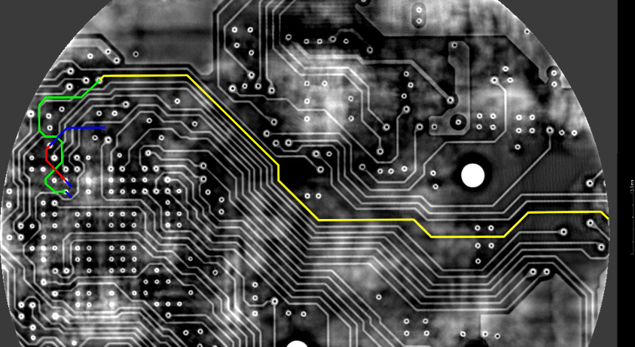
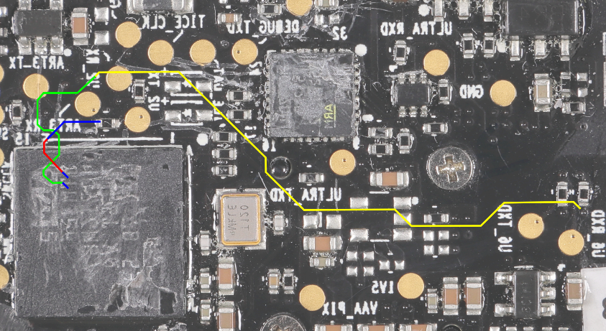
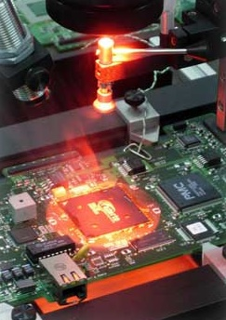
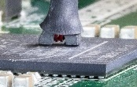
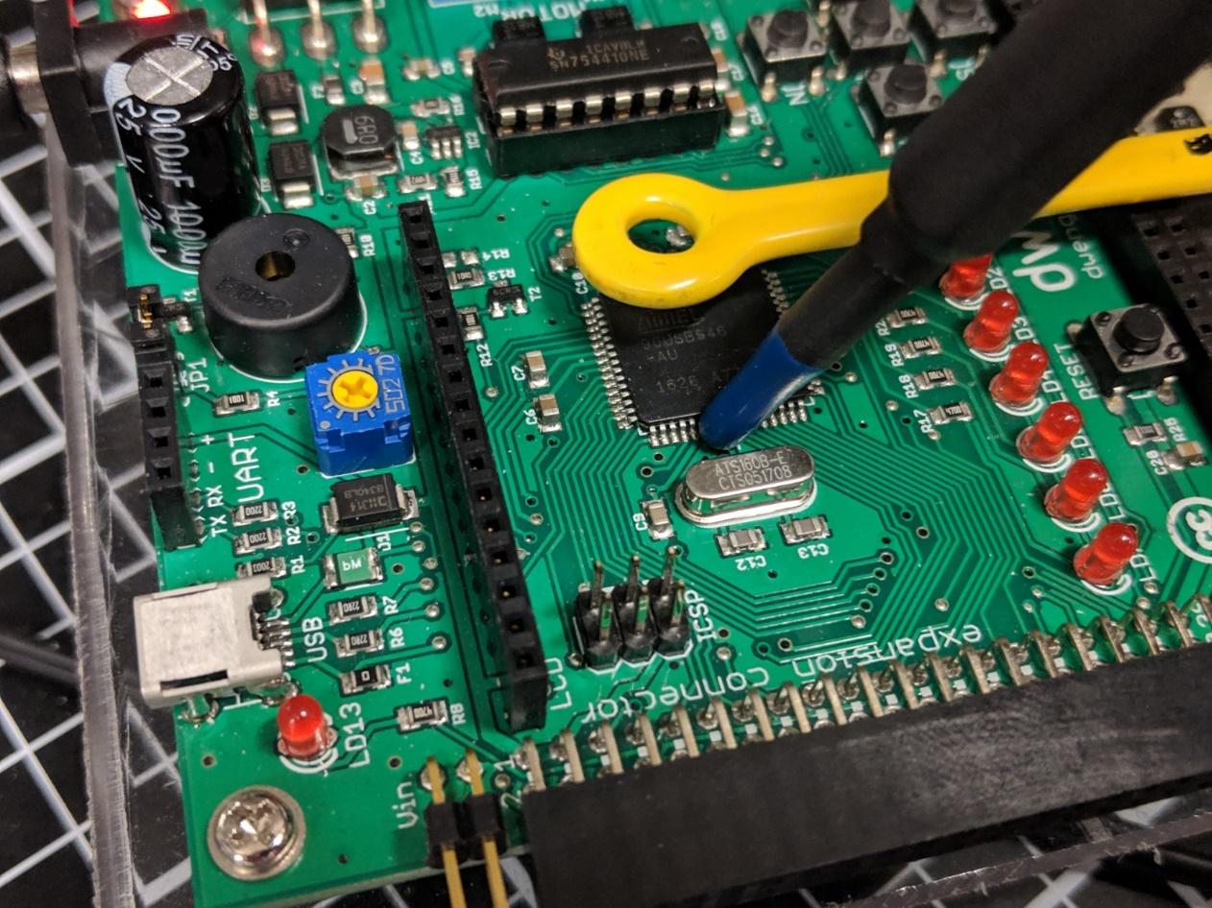
What is “Embedded Security”?
Examples
embedded devices are often…
…used “at the edge” - exposed to physical/proximal attacks
…resource-constrained - traditional protection too costly
- difficult to patch/update
…part of a cyber system - expands attack surface / complicates RE
Foundational Skills
Electrical engineering
Signal processing
Comm systems / RF
Computer architecture
Embedded software
Semiconductor / VLSI
Digital Logic

Slide 6
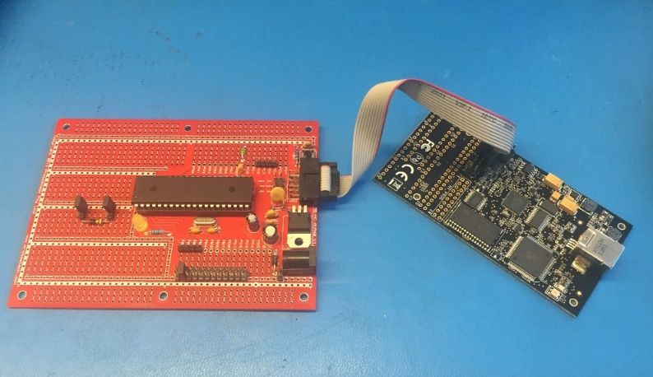
Key Components to the eCTF
Focus on Embedded Security
Extended Time
Attack and Defend

Slide 7
Key Components to the eCTF
Focus on Embedded Security
Main target is a physical or emulated embedded device​
Open scope of attacks to include physical/proximal access attacks​
Side Channel Analysis
Hardware trojans
Fault injection

Slide 8
Key Components to the eCTF
Secure Design
Handoff
Begins late February
eCTF Organizers verify that each design has met all the functional requirements
eCTF Organizers post verified designs for all teams to evaluate during the attack phase
Attack
Teams perform a security evaluation of opposing teams' systems
Teams demonstrate attacks by retrieving flags
Begins early to mid January
Teams attempt to solve development challenges to retrieve design-phase flags
Teams design a secure system that meets all the challenge requirements
Begins immediately after successful completion of Handoff
Scoreboard closes mid April
Teams submit their designs to the eCTF Organizers
Extended Time
Allow sufficient time for in-depth exploration and sophisticated attacks​
Most embedded device development (and attack development) requires more time than the equivalent activities with pure-software

Slide 9
Key Components to the eCTF
Secure Design
Handoff
Begins late February
eCTF Organizers verify that each design has met all the functional requirements
eCTF Organizers post verified designs for all teams to evaluate during the attack phase
Attack
Teams perform a security evaluation of opposing teams' systems
Teams demonstrate attacks by retrieving flags
Begins early to mid January
Teams attempt to solve development challenges to retrieve design-phase flags
Teams design a secure system that meets all the challenge requirements
Begins immediately after successful completion of Handoff
Scoreboard closes mid April
Teams submit their designs to the eCTF Organizers
Attack and Defend​
Puts participants through the exercise of trying to create a secure system and learning from their mistakes
All Flags are “Real” Vulnerabilities
Students learn about realistic and common mistakes

Slide 10
Student Feedback
“This CTF… motivated me to dive in deeper and work that much harder to get better as an engineer. The MITRE staff was AMAZING! Thank you for this opportunity.” -eCTF participant
100%
Learned more about embedded system security
93%
Enjoyed participating in the eCTF
“This competition exposed an entirely new side of cybersecurity to me as a Computer Science major… [It] was a great learning experience and got me interested in lower-level security” -eCTF participant

Slide 11
Why do the eCTF?
Unparalleled hands-on experience
Crypto/protocol design
Low-level C programming
Real-world offensive security
Project management
Career advancement
Looks great on a resume
Massive talent supply shortage in embedded security
Internship and hiring opportunities at MITRE and Riverside Research
Course credit
Work with your faculty advisor to set up a special topics or independent study course
Example syllabus is available
Cash prizes
It’s fun! (but a lot of work)

Slide 12
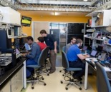
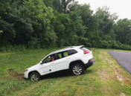







The History and Growth of eCTF
01
02
03
04
05
06
1st eCTF Event
Interns only
Laid groundwork for future events
2nd eCTF Event
New challenge
Changed hardware platform to improve scalability
3rd eCTF Event
Included MITRE sites
New challenge
Changed hardware platform to reduce cost
4th eCTF Event
Collaboration w/ Riverside Research
New challenge and hardware platform
5th eCTF Event
Expand collaboration w/ Riverside
Doubled number of schools
6th eCTF Event
Built emulation support
Enabling remote participation
2015
2016
2017
2018
2019
2020
Q3
Q4
Q1
Q2
Q3
Q4
Q1
Q2
Q3
Q4
Q1
Q2
Q3
Q4
Q1
Q2
Q3
Q4
Q1
Q2
Q3
Q4
6th Collegiate eCTF
1st Collegiate eCTF
2nd Collegiate eCTF
3rd Collegiate eCTF
4th Collegiate eCTF
5th Collegiate eCTF

Slide 13
















eCTF 2021 Participating Schools

Slide 14
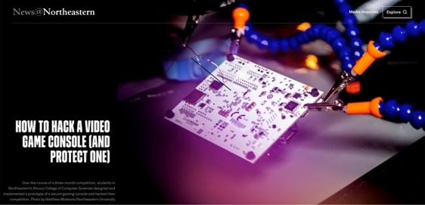

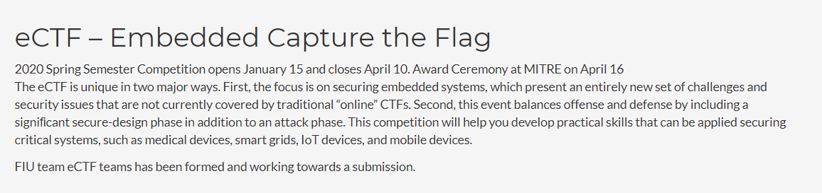

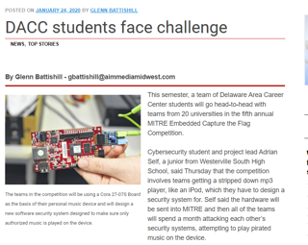
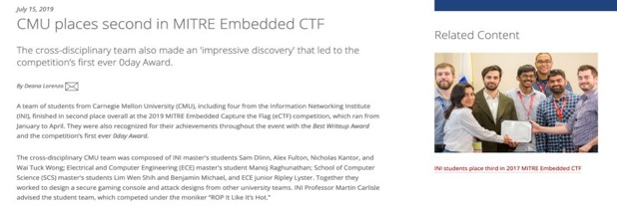
eCTF In the News

Slide 15
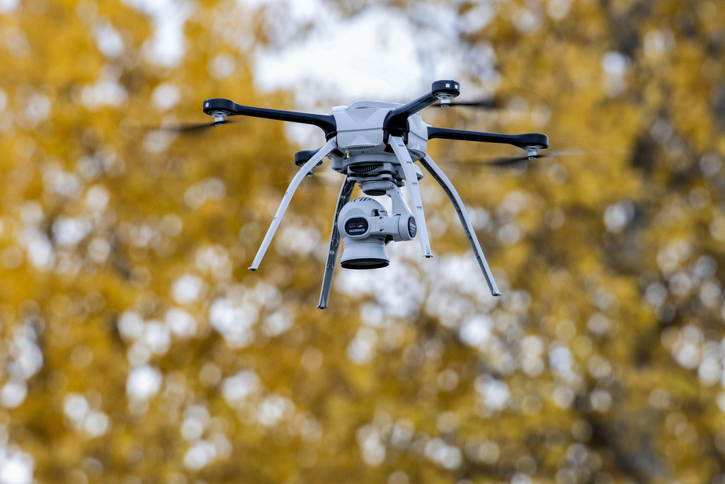
What is this year’s challenge?
Secure the firmware of an avionic device
Design and implement a system for secure firmware updates
Protect intellectual property and aircraft mission secrets
Understand and mitigate threats to the microelectronics supply-chain
Mitigate damage from potential hardware trojans
Design hardware trojans to defeat your opponents

Slide 16
Next Steps
Find a faculty advisor
All teams require at least one faculty advisor to help guide the team
Potential advisors can contact ectf@mitre.org to help get started
Register your team
Find registration link at https://mitrecyberacademy.org/competitions/embedded/
Send any questions to ectf@mitre.org
Sep
Dec
Mid-Jan
Late Feb
Early Apr
Mid-Apr
Team Registration Opens
Individual Competitor Registration Opens
eCTF Kickoff
Attack Phase Begins
Attack Phase Ends
Award Ceremony

Slide 17
Questions?
https://mitrecyberacademy.org/competitions/embedded/
ectf@mitre.org
© 2021 THE MITRE CORPORATION. ALL RIGHTS RESERVED. Approved for public release. Distribution unlimited 20-03314-12.

